Slide 1
C
CATAWBA COLLEGE
DATA MINING · FINAL PROJECT
Loan Approval Classification
Supervised Learning · End-to-End Modeling Workflow
PROJECT TITLE
STUDENT NAME
DATE
Loan Approval Classification- Final Exam
Haley Benge
04/28/2026
CIS 3902

Slide 2


CATAWBA COLLEGE
01 · PROBLEM
Problem Statement & Objective
Frame the problem, clarify the target, justify the work
01
Motivation
Loan approval applications can be time consuming and inconsistent. This model automates the decision-making process, reducing time and ensuring consistent results.
Introduction
[ This analysis uses classification models to determine loan approval status based on key features. ]
02
Prediction Target
The model is predicting loan_status as Approved or Rejected.
03
Impact
This model can help financial institutions make quicker and more reliable decision while reducing manual workloads, and minimizing risky lending
Data Mining · Final Project
1 / 10

Slide 3




CATAWBA COLLEGE
02 · DATASET
Dataset & Domain Context
Where the data comes from and why it fits the problem
AT A GLANCE
Source & Citation
Sharma, A. (2023). Loan approval dataset. Kaggle. Loan-Approval-Prediction-Dataset
#
rows
4,269 application
Size & Structure
#
features
Contains 4,269 rows representing loan applications, and 13 columns describing applicants financial and demographic information, with a mixture of numerical (annual income, loan amount, credit score) and categorical (education, loan status) variables.
13
—
target type
Domain Relevance
Classification
This dataset contains features that are commonly used in lending decisions. Variables such as income, credit history and loan amount directly reflect the factors used to assess credit risk in real-world application. Limits to this dataset include simplification, potential bias in data, and class imbalance affecting predictions.
Data Mining · Final Project
2 / 10

Slide 4

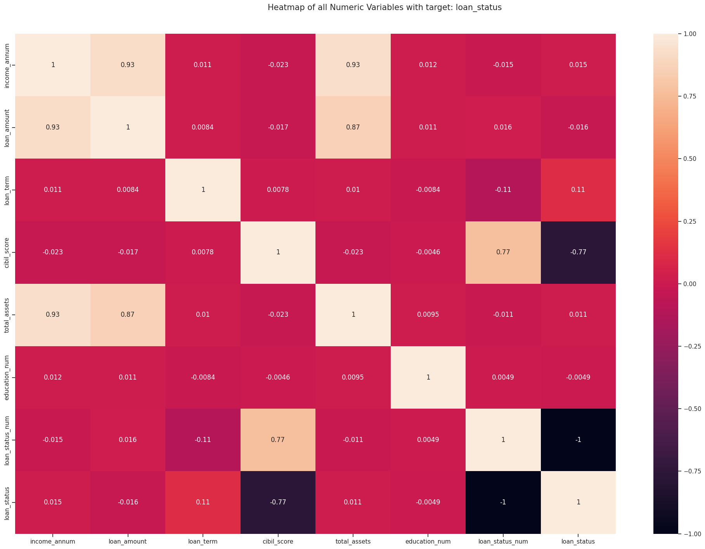

CATAWBA COLLEGE
03 · EXPLORATION
Data Exploration & Key Insights
What the data reveals before any modeling happens
WHAT TO COVER
Summary statistics
Class Balance: 2656 Approved (62.2%) and 1613 Rejected (37.8%)
Credit Score: Mean (599.9) & Stdv (172.4)
Loan Term: Mean (10.9 years) & Stdv (5.7 years)
Visuals
Histograms, correlations, box plots, pair plots.
[ Paste your EDA visualization here ]
Histogram · Correlation heatmap · Scatter · etc.
Notable trends & outliers
- The “-1” that are found in the heatmap are due to the encoded variables.
- Education has little relationship with loan status
Important Note:
- Categorical versions of these encoded variables will be dropped, as well as variables with little/no relationship.
Data Mining · Final Project
3 / 10

Slide 5


CATAWBA COLLEGE
04 · PREPARATION
Data Cleaning & Feature Engineering
From raw dataframe to model-ready matrix
01
Handle Missing Data
02
Encoding & Discretization
03
New Feature Creation
-There was no missing data, but several columns were dropped throughout the analysis.
loan_id → uniqueness
self_employed → lack of correlation
no_of_dependents → lack of correlation
Binary encoding was used to encode education, self_employed and loan_status.
MinMax scaling was used to scale income_annum and total_assets
A feature called total_assets was created using the sum of residential_assets_value, commercial_asset_value, luxury_assets_value, and bank_assets_value.
After creating a total assets columns, the other assets columns were dropped.
COMMON TOOLS
COMMON TOOLS
COMMON TOOLS
dropna
fillna
KNNImputer
get_dummies
LabelEncoder
pd.cut
ratio
datetime
interaction
Data Mining · Final Project
4 / 10

Slide 6

CATAWBA COLLEGE
05 · METHOD
Model Selection & Method
The algorithm, the reasoning, the tooling
ALGORITHM
Why This Choice?
Random Forest
Strong baseline · handles mixed feature types · captures non-linearities · good for explainable AI (feature importance, SHAP).
In comparison, this model had the best performance.
FAMILY
Supervised · Ensemble · Tree-based
Tools & Libraries
ALTERNATIVES CONSIDERED
Logistic Regression · XGBoost · SVM
PyCaret
scikit-learn
pandas
matplotlib
SHAP
Data Mining · Final Project
5 / 10

Slide 7

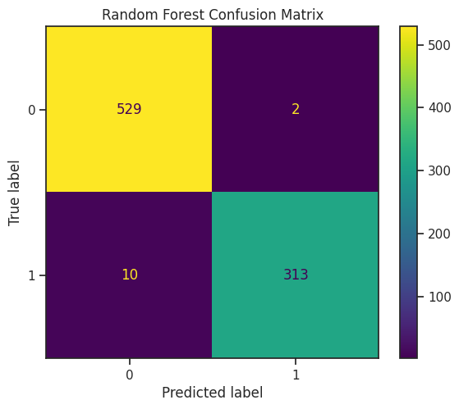
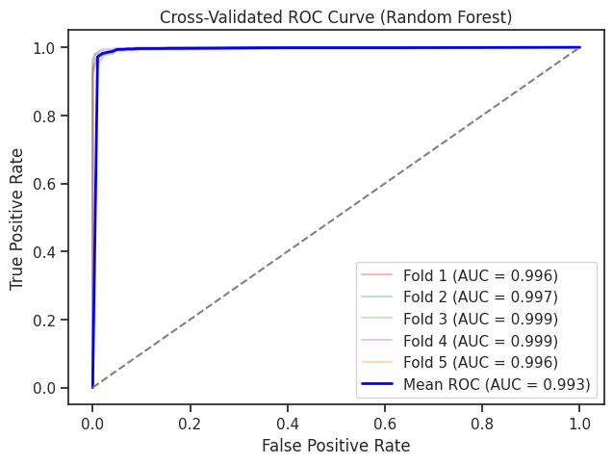
CATAWBA COLLEGE
06 · EVALUATION
Model Evaluation & Tuning
How well it works — and how you made it better
0.99
0.99
ACCURACY
AUC
[ Screenshot: Confusion Matrix ]
Overall correctness
Ranking quality
Confusion Matrix
0.98
1.00
PRECISION
RECALL
Of predicted positives
Of actual positives
HYPERPARAMETER TUNING
ROC Curve
Cross validation was used to ensure the model generalizes well.
Data Mining · Final Project
6 / 10

Slide 8

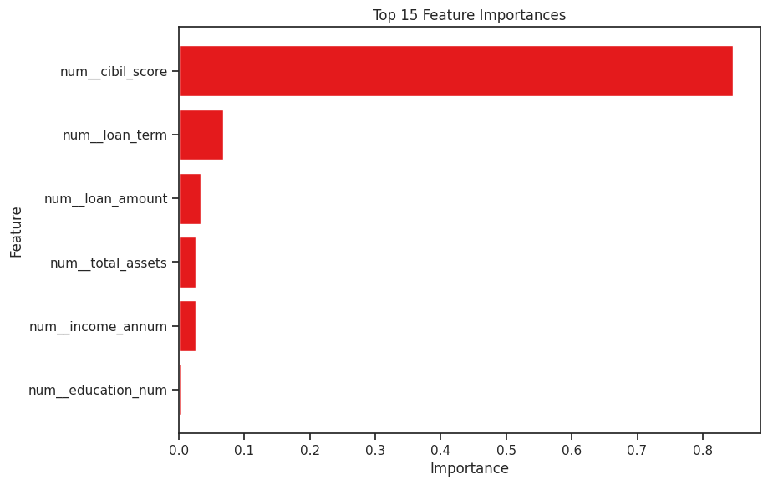

CATAWBA COLLEGE
07 · INTERPRETATION
Feature Importance & Interpretation
Which features drive the predictions, and what it means
TOP FEATURES
1
cibil_score
2
loan_term
[ Feature importance plot ]
3
loan_amount
4
total_assets
INTERPRETATION
5
education_num
The top feature is credit score which is not surprising. Financial institution focus heavily on credit score when making lending decision because it acts as a numerical representation of a person’s reliability in repayment. This does not suggest leakage or bias as it was a legitimate input available prior to decision making and its importance aligns with its strong correlation to the target variable.
Data Mining · Final Project
7 / 10

Slide 9


CATAWBA COLLEGE
08 · REFLECTION
Limitations & Next Steps
What’s imperfect, what’s next
LIMITATIONS
ETHICS & BIAS
ROADMAP
Model Limitations
Data Issues & Bias
Future Work
There was a moderate class imbalance (62/38) which may cause the model to slightly favor the Approved class
It is unknown how/where the data was collected which could lead to bias and fairness concerns
Credit score has a major impact on loan status which could put some groups of people at a systematic disadvantage
The model could be too simplistic, it does not include context or non-traditional indicators of reliability
More data · better features · try stronger models (gradient boosting, neural nets) · deploy via API · monitor drift in production.
Data Mining · Final Project
8 / 10

Slide 10
CATAWBA COLLEGE
08 · REFLECTION
Other Model
Same data, different models
Gradient Boosting
Accuracy: 0.98
Precision: .99
Recall: .99
F1 Score: .99
ROC ACU: .99
Logistic Regression
Accuracy: .92
Precision: .93
Recall: .93
F1 Score: .96
ROC AUC: .96
Decision Tree
Accuracy: .98
Precision: .99
Recall: .98
F1 Score: .99
ROC AUC: 1.0
Data Mining · Final Project
9 / 10

Slide 11



CATAWBA COLLEGE
09 · REFERENCES
References & Acknowledgments
Include use of AI
DATA SOURCES
GITHUB REPOSITORY
[ QR CODE ]
Sharma, A. (2023). Loan approval dataset. Kaggle. Loan-Approval-Prediction-Dataset
Scan to view code, data & notebooks
OpenAI. (2026). ChatGPT (GPT-5.3) [Large language model]. https://chat.openai.com/
github.com/haley8105
Issues · Pull Requests welcome
TOOLS & LIBRARIES
Python
PyCaret
scikit-learn
pandas
THANK YOU
matplotlib
AutoViz
Questions welcome.
[ Acknowledgments: instructor, collaborators, data providers ]
Data Mining · Final Project
10 / 10
Data Mining · Final Project
10 / 10

